Slide 1



IMAGE STEGANOGRAPHY USING MODIFIED DWT TECHNIQUE

Slide 2

Agenda
Introduction to steganography
Steganography vs Cryptography
Overview of image Steganography
DWT technique
Drawbacks of DWT technique
Modified DWT technique implementation
Conclusion

Slide 3
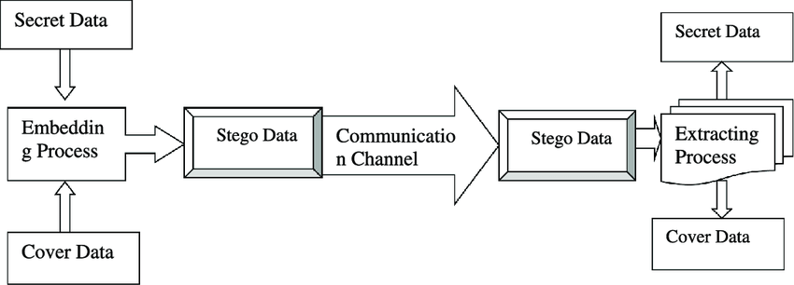
Steganography
In simple terms, steganography is a technique of hiding one piece of information within another in a way that isn't obvious to anyone who doesn't know where or how to look..
Features: Information Protection, Secure Communication, Preventing Data Interception.

Slide 4
Need of Steganography
Confidential Communication:
Secure Messaging: Steganography can be used to hide sensitive information within seemingly innocuous data, such as images or audio files, allowing users to communicate covertly.
Data Encryption: Concealing encrypted messages within another medium adds an extra layer of security, making it harder for unauthorized individuals to detect or intercept sensitive data.
Authentication:
Tamper Detection: Steganography can be used to embed authentication codes or hidden markers within digital media to detect any unauthorized alterations or tampering.
Integrity:
Integrity refers to the assurance that the hidden information remains unaltered and intact during the process of embedding and extraction

Slide 5
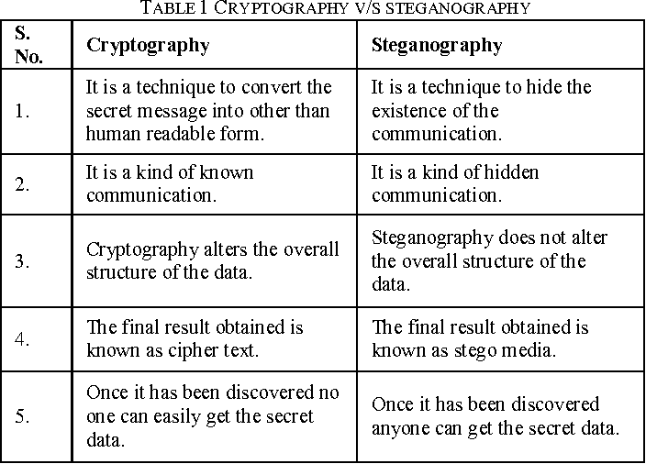

Slide 6
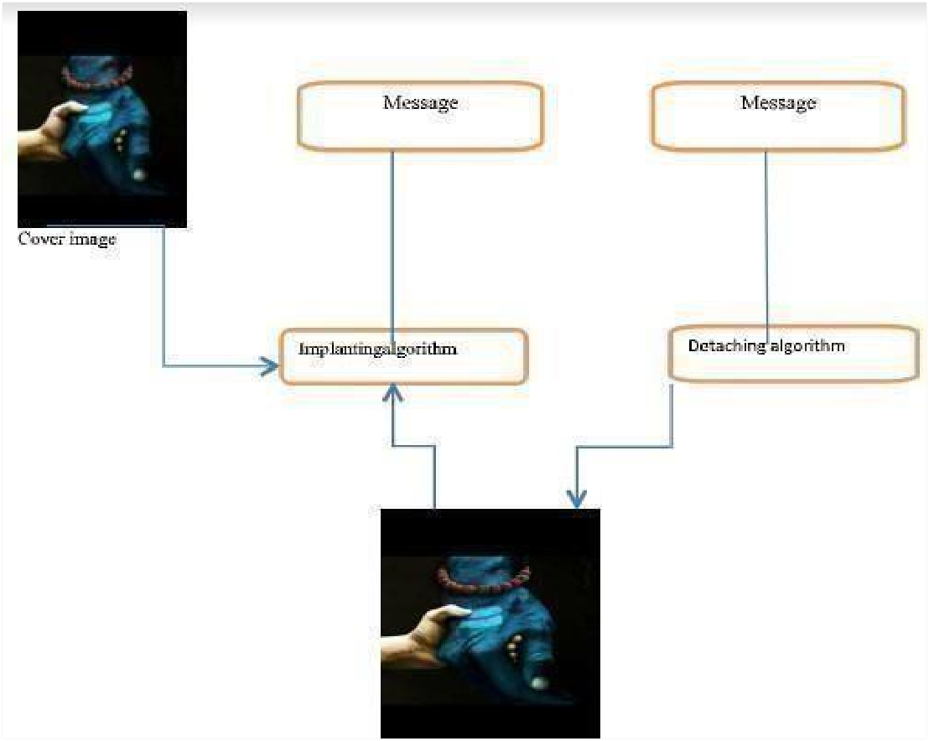
Image Steganography
Image steganography is a technique of hiding secret information within an image without affecting its visual quality. In image steganography, the secret data is embedded within the pixels of the image using various algorithms.
Terminologies used in Image Steganography:
Covered Image: Real image acting as a carrier for the hidden file.
Steganographic Image: The embedded information inside the cover image is steganographic image.
Message: Informationwhich is actually hidden into images, it can be a image or a plain text.
Steganographic key: For getting the message from steganographic image, steganographic key isused.
Implanting Algorithm: For hiding the information inside the image, an algorithm is used.
Detaching Algorithm: For getting the information from steganographic image, an algorithm is used.

Slide 7
Types of image Steganography
Spatial domain technique
In simpler terms, these techniques operate on the raw pixel data of an image without transforming it into a different domain and they are 3 types
1. LSB(LEAST SIGNIFICANT BIT)
2. Random Pixel Embedding
3. Pixel-Value Differencing (PVD):
Transform domain technique
it convert the image from its spatial representation (pixel values) into a frequency or transform domain. then it manipulates the data.
1. Discrete Cosine Transform (DCT)
2. Discrete Wavelet Transform (DWT)):

Slide 8
Discrete Wavelet Transform (DWT)):
DWT is used to transform images into frequency components. Steganography can be performed by modifying the coefficients in the wavelet domain.
Problems with DWT technique:
1 . There is a clear chance of getting a fraction value. If we ignore the fraction value and just store the decimal value we cannot get the same coefficients from the pixels when extracting the data. This leads to errors in the extracted data, so we need to store the fraction values.
2. Another issue we have is the possibility of a negative value that cannot be stored in an image. Ignoring the sign will lead to false data in extracting process.
3. There is also a chance of exceeding the limit of 255.
There are many techniques and tricks such as storing the decimal values separately in the form of the description of the Image or dividing the pixel value by 2 since the range of possible values goes from -256 to 256 dividing by 2 doubles the range. But it affects the quality of the embedded image significantly. Storing decimal values required additional memory.

Slide 9
In order to address the said issues effectively we propose the following solution.
In this approach in order to solve the possibility of negative values we use a different set of formulas as follows.
d1 = p1 + p3 + p4 - 2*p2
d2 = p2 + p4 + p1 - 2*p3
d3 = p3 + p1 + p2 - 2*p4
d4 = p4 + p2 + p3 - 2*p1
The above set of formulae is used for calculating the coefficients. After embedding the data the following formulas perform Inverse DWT to generate an Image from new coefficients D1, D2, D3, and D4.
P1 = (D1 + D2 + D3) / 3
P2 = (D2 + D3 + D4) / 3
P3 = (D3 + D4 + D1) / 3
P4 = (D4 + D1 + D2) / 3
When performing LSB the pixel value is changed by at most 1 which is not visible to the naked eye. Since the Inverse DWT formulas don’t contain a negative sign we can safely rule out the possibility of a negative value. We still have the fraction values as we are dividing the sum by 3. To solve this issue we use a simple trick to store the fraction data within the pixel itself. To solve the fraction issue we first divide the pixel value by 3 before calculating the coefficients. The division is a floor division. Let p1, p2, p3, p4 be the pixels and np1, np2, np3, np4 be the pixel values after the division by 3. i.e. np1=p1/3 and so on. Since we have pixels divided by 3 we can safely remove the division by 3 in the IDWT step.

Slide 10
But we still need to calculate the coefficients while extracting the data which requires the pixel values to be the same when calculated by the IDWT formula. In order to save the fractional value we remove the division by 3 from IDWT and recalculate them to the divided version when calculating the coefficients.
1. Embedding step
np1 = ⌊p1/3⌋
np2 = ⌊p2/3⌋
np3 = ⌊p3/3⌋
np4 = ⌊p4/3⌋
d1 = np1 + np3 + np4 - 2*np2
d2 = np2 + np4 + np1 - 2*np3
d3 = np3 + np1 + np2 - 2*np4
d4 = np4 + np2 + np3 - 2*np1
P1 = (D1 + D2 + D3)
P2 = (D2 + D3 + D4)
P3 = (D3 + D4 + D1)
P4 = (D4 + D1 + D2)

Slide 11
2. Extracting step
nP1 = P1/3
nP2 = P2/3
nP3 = P3/3
nP4 = p4/3
d1 = np1 + np3 + np4 - 2*np2
d2 = np2 + np4 + np1 - 2*np3
d3 = np3 + np1 + np2 - 2*np4
d4 = np4 + np2 + np3 - 2*np1
Since the floor division by 3 only takes away of utmost 2 pixels it is negligible and not visible to the naked eye.
Handling Edge Case
In the IDWT formulas , Since we are adding the values there might be a chance of overflow. This can be seen in the example when p1 = 255, p2 = 255, p3 = 255, and p4 = 0. Then the new pixels will be np1 = 85, np2 = 85, np3 = 85 and np4 = 85. Then the coefficients will be d1 = 0, d2 = 0, d3 = 255 and d4 = 0. When data is embedded using LSB, the coefficients might become d1 = 1, d2 = 1, d3 = 255, and d4 = 1. In such cases, the value exceeds the limit. To solve this issue we can do a border correction step which includes subtracting the new pixel values by 2 which only changes the value by at most 7 pixels which doesn’t affect the quality of the embedded image.

Slide 12
REFERENCES
[1] An Overview of Different Type of Data Hiding Scheme in Image using Steganographic Techniques Mukesh Garg Volume 4, Issue 1, January 2014 ISSN: 2277 128X International Journal of Advanced Research in Computer Science and Software Engineering Research Paper is Available online at: www.ijarcsse.com.
[2] International Journal of Engineering and Advanced Technology (IJEAT) ISSN: 2249 – 8958 (Online), Volume-9 Issue-4, April, 2020.
[3] International Refereed Journal of Engineering and Science (IRJES) ISSN (Online) 2319-183X, (Print) 2319-1821 Volume 6, Issue 1 (January 2017), PP.68-71
[4] International Journal of Science and Research (IJSR) ISSN (Online): 2319-7064 Impact Factor (2012).

Slide 13
Any Questions ?

